Slide 1

SQL Server Admin Best Practices with DMV's
William Assaf, Sparkhound

Slide 2
SQL Server Admin Best Practices with DMV's
An incomplete tour of SQL Server DMV’s, covering the most important topics and getting you started on getting the most you can out of these crucial performance indicators.

Slide 3
Audience
Everyone can benefit from knowledge of these helpful tools, from developers to report writers to DBA’s of all levels of experience.

Slide 4
Purpose of this Presentation
There are far too many DMVs to be covered in the scope of this presentation, here are the most useful and popular.
Getting anything out of DMVs will require you to try them yourself.
Short, quick-hitting labs throughout.
We won’t get to all Labs, but you can!
Share practical, everyday uses and scripts.

Slide 5
STOP ME
If you have a question
If you have used the DMV in an interesting, practical way
If you’d like to stare at the TSQL code a little bit longer
Don’t worry – slides and samples will be posted on my blog at SQLTact.com
Some labs use Microsoft’s WideWorldImporters sample database: https://github.com/Microsoft/sql-server-samples/releases/tag/widWideWorldImporters-Full.bake-world-importers-v1.0
Toolbox for all Labs on Github:
github.com/sparkhoundsql/sql-server-toolbox

Slide 6
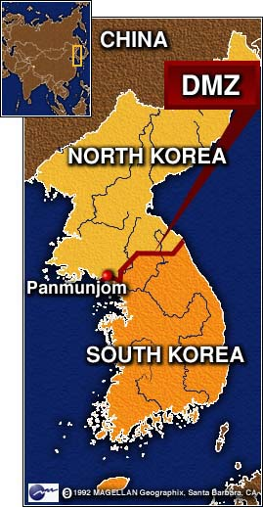

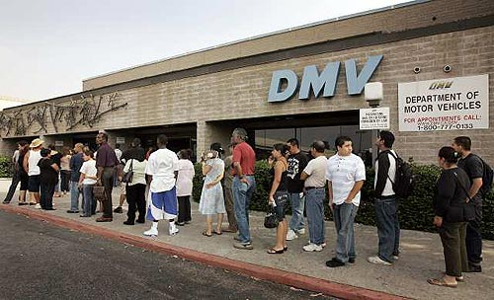




What Is a DMV?
Dynamic Management Views are in place to provide system transparency.
The DMV’s we are talking about today are the foundation of countless third party SQL monitoring applications.

Slide 7
What Is a DMV?
They all fall into a category of DMO’s.
Some are DMF’s, table-valued Functions with parameters.
For these purposes, we will call them all DMV’s, because we can make more jokes about DMV’s.
Notes:
They could also be called DMO’s, Dynamic Management Objects, but that acronym is already taken by Distributed Management Objects.

Slide 8
What Is a DMV?
Most DMO’s in this session work back to SQL 2005 (90).
Some database-level DMV’s require the database to be in the needed compatibility mode or higher
Some towards the end of the presentation have been introduced more recently, including some in SQL 2019
Often, DMV changes are included for older versions via Service Packs or Cumulative Updates.
Most of this content applies to SQL Server, Azure SQL, SQL on Linux, and Azure SQL Managed Instance.

Slide 9
Permissions
Most DMV’s require only:
VIEW SERVER STATE
or
VIEW DATABASE STATE
grant view server state to [sparkhound\william.assaf] grant view database state to [sparkhound\william.assaf]
These are read-only permissions that may be appropriate for developers in prod.

Slide 10
Ready?

Slide 11
sys.dm_os_wait_stats
Aggregated wait times – records when something has to wait and retains it.
Records count of tasks experiencing the wait type, sum of time and max time waiting.
There are 1054 (more or less documented)
wait types in SQL 2019 CTP 3.0.
Notes:
Best to exclude types that match ‘%SLEEP%’ because those are related to db system startup waits or background task waits and shouldn’t be considered part of user performance.

Slide 12
sys.dm_os_wait_stats
Wait Stats can be powerful diagnostic tools.
Many performance suits do little more than incorporate Wait Stats data for charts in their dashboards, but they also are great sponsors of user groups and SQLSaturday events!

Slide 13
sys.dm_os_wait_stats
ONDEMAND_TASK_QUEUE – high wait times of this type indicate lots of SQL Server idle time. You can ignore/disregard this.
These wait times also indicate idling and are not problematic:
BROKER_TRANSMITTER BROKER_RECEIVE_WAITFOR DBMIRROR_WORKER_QUEUE KSOURCE_WAKEUP CLR_AUTO_EVENT LOGMGR_QUEUE REQUEST_FOR_DEADLOCK_SEARCH QDS_SHUTDOWN_QUEUE
and many many more..

Slide 14
sys.dm_os_wait_stats
LCK_M_* - Lock waits
Reference sys.dm_tran_locks if this number is consistently at the top of the server’s waits.
This is a sign of transaction contention.
Could be that poor queries/indexing are creating too many scans, where a nonclustered index seek could relieve this pressure.
Synchronous AvailabilityGroup replicas could increase this wait type.
Lots of LCK_M_ waits?
Consider RCSI – Read Committed Snapshot Isolation
Stop adding NOLOCK to your queries, this is dangerous.

Slide 15
sys.dm_os_wait_stats
CXPACKET – clear indication of excessive execution plan parallelism and CPU is struggling to keep up.
Look into MAXDOP settings, it may be appropriate to reduce large parallel queries from impacting performance
MAXDOP can be configured server-wide, but also in recent versions of SQL Server, at the query level or database level
Enforcing MAXDOP is one of the better implementations of the Resource Governor (Enterprise-only) for select connections

Slide 16
sys.dm_os_wait_stats
SOS_SCHEDULER_YIELD – clear indication of CPU pressure when this is the highest wait
Too many runnable tasks for available threads
A SQL stopped operation and “yielded” to another CPU task
Increasing CPU is the simplest but most difficult and expensive
Look for and reduce CPU-intense queries (more on how later)

Slide 17
sys.dm_os_wait_stats
RESOURCE_SEMAPHORE – request is waiting on memory to be gathered before starting
Indication of memory pressure caused by:
Insufficient system memory (unlikely)
Poor query design, poor indexing, inefficient execution plan (likely)

Slide 18
sys.dm_os_wait_stats
PAGELATCH_xx - Nothing to do with Physical IO. Multiple threads are attempting to access a page in memory. Contention over a page in memory.
Could be tempdb temp tables are being overused.
Could be an INSERT statement hotspot on a table.
PAGEIOLATCH_xx – This is Physical IO, reading data from disk into memory. Hard disks/SAN are struggling to keep up.
Often this is because of inefficient application code
Or, executives/analysts/goons are running MS Access or Excel and pulling down entire tables

Slide 19
sys.dm_os_wait_stats
PAGELATCH_xx - New in SQL 2019 - A new index option OPTIMIZE_FOR_SEQUENTIAL_KEY specifically for tables with clustered keys on IDENTITY and SEQUENCE that have high write volumes, creating “hot spots” for sequential inserts.
If you observe high amounts of PAGELATCH_EX, it may be because of contention for individual pages in memory due to sequential inserts.
This new index option improves performance for tables that have a sequential key. https://docs.microsoft.com/en-us/sql/t-sql/statements/create-index-transact-sql?view=sqlallproducts-allversions#sequential-keys

Slide 20

sys.dm_os_wait_stats
ASYNC_NETWORK_IO – Common, caused by waits involving the reception of data by the remote clients.
Almost certainly not caused by the network.
Almost certainly caused by poor queries, such as SELECT *’s with no WHERE clause
Look for queries with high row counts
Will be caused by Office apps that query entire tables →

Slide 21
sys.dm_os_wait_stats
When to analyze?
Use on healthy or troubled systems, look for trending from a baseline.
Determine which waits are impacting performance server-wide. It is one of the best DMV’s for server-wide performance.

Slide 22
sys.dm_os_wait_stats
This number is a forever-growing aggregate.
Which means over time, recent changes will not affect the large aggregate numbers well.
For your performance-sensitive servers, consider a regimen of collection and manual wiping the stats weekly or daily.
Demo of this in Lab: dm_os_wait_stats.sql

Slide 23

sys.dm_os_wait_stats
Again, sys.dm_os_wait_stats is aggregated at the instance level.
Doesn’t include live data.
Doesn’t include request- or session-level data.
For that you’ll need the next DMV…

Slide 24
sys.dm_os_waiting_tasks
Shows waits for current requests, not aggregated.
Not much different from the current wait information in sys.dm_exec_requests (more on that important DMV later)

Slide 25
sys.dm_exec_session_wait_stats
New in SQL 2016 – Shows waits for the current session.
Instead of server-wide waits or current waits, we can drill into specific query waits aggregated with the session so far, since it connected.
The syntax is the same as the aggregated sys.dm_os_wait_stats, but includes an extra column for session_id.

Slide 26
Summary of Wait Type DMV’s
Labs:
dm_os_wait_stats.sql - Aggregate Waits
dm_os_waiting_tasks.sql – Live Session-level Waits
dm_exec_session_wait_stats.sql – Aggregate Session-level Waits

Slide 27
sys.dm_exec_query_stats
Stores performance information about the cached query plans in memory, but rows do not persist after a plan is removed from the cache (or an instance restart).
Provides a sql_handle and offsets (integers) to identify the statement within a batch or stored procedure using sys.dm_exec_sql_text.
One row per query statement within cached plan.

Slide 28
sys.dm_exec_query_stats
Used for in-depth performance tuning
Find the “worst” queries in terms of total_worker_time (CPU), rows and duration
Records total writes, total reads and can be used in summary to measure activity.

Slide 29
sys.dm_exec_query_stats
Lab:
Worst query plans.sql
But wait! SQL 2016+’s Query Store feature contains more and better information and functionality.
Query Store is SO GOOD, that I no longer recommend using a “Worst Query Plans” script based on sys.dm_exec_query_stats in SQL 2016+. Enable Query Store today! It is NOT enabled by default.

Slide 30
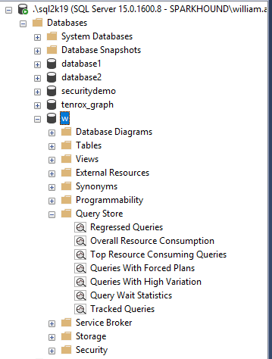
Query Store
Built-in reports make analysis easy
This isn’t enabled by default.
Go enable it.
Minimal overhead – collected data is stored asynchronously, flushed to disk periodically

Slide 31
Query Store
New in SQL 2016, even better in SQL 2017.
Starting with SQL 2017, Query Store tracks Wait Stats too!
A feature that was developed for Azure SQL first.
Tracks the performance of queries – not of execution plans – a distinct difference. Can detect when a query has suffered a degradation in performance because its query plan has changed.

Slide 32
Query Store
The “worst plans in cache” is a common strategy to identify the most expensive plans
The Query Store is one step better – finding the recent “worst queries” regardless of plan, with sortable/aggregable metrics to launch your performance tuning as a developer or DBA.

Slide 33
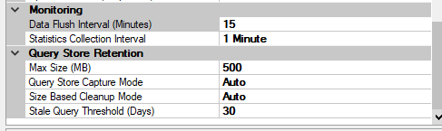

Query Store
Data Flush Interval
In-memory Data buffer.
Defaults to 15 minutes.
Statistics Collection Interval
Defines the automatically generated time windows for aggregated statistics on that interval. Default 1 hour.
Max Size (MB)
Actual space on disk inside the user database. Default 100 MB probably isn’t enough to track busy history.

Slide 34
Query Store
By default Query Store automatically cleans up, removing the least expensive and oldest queries first as the data approaches the Max Size (MB).
You can also manually clear the Query Store data (for testing only) with the command:
ALTER DATABASE [WideWorldImporters] SET QUERY_STORE CLEAR

Slide 35
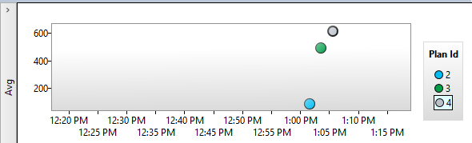
Query Store
Regressed Queries highlights query execution over time
Bad!
A lot of reasons queries could regress, dropping indexes (results in a new plan) is easy reproduced
Plans could be flushed from cache, recreated differently
Other reasons: parameter sniffing, changing or outdated statistics, the modern Cardinality Estimator first in compat 12.0 (2014).

Slide 36
Query Store – Next Logical Step?
What if SQL Server could use information about Regressed Queries and a history of execution plans to decisions to automatically use a better plan?
Now it can!
Automatic Plan Correction (new to SQL 2017)!
Again, Azure SQL Database already does this for you!

Slide 37
Automatic Plan Correction
“Automatic Plan Tuning” is based on Query Store
Available in Azure SQL and now in SQL 2017 to revert a query from a newer, slower plan to an older, faster plan.

Slide 38
Automatic Plan Correction
You can also accomplish this manually yourself, or query the underlying information yourself, with a host of DMV’s including sys.dm_db_tuning_recommendations
Sample query: https://docs.microsoft.com/en-us/sql/relational-databases/automatic-tuning/automatic-tuning

Slide 39
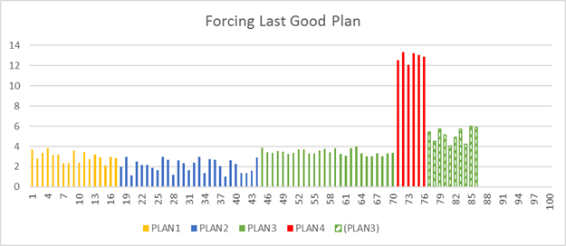
Automatic Plan Correction
https://docs.microsoft.com/en-us/sql/relational-databases/automatic-tuning/automatic-tuning#automatic-plan-correction

Slide 40
Automatic Plan Correction
Not on by default, you must enable
Database Engine will automatically force any recommendation where the estimated CPU gain is higher than 10 seconds.
ALTER DATABASE WideWorldImporters
SET AUTOMATIC_TUNING ( FORCE_LAST_GOOD_PLAN = ON );

Slide 41
sys.dm_exec_sessions
Queryable session info
Includes connection identification info
Replaces the old system view sys.sysprocesses
Often joined to…

Slide 42
sys.dm_exec_requests
Shows current activity, like “SP_WHO2 active”
Shows only active requests (ignores SLEEPING)
Main hub for many DMO’s providing request info, often joined with others.
Provides a sql_handle and offsets (integers) to identify the statement within a batch or stored procedure using sys.dm_exec_sql_text

Slide 43
sys.dm_exec_requests
Use the helpful percent_complete column to check progress of BACKUP and RESTORE.
Also applies to DBCC CHECKDB operations!
Combined with the start_time value, can estimate a completion datetime as well.
Lab:
Backup restore progress.sql

Slide 44
sys.dm_exec_input_buffer
DBCC INPUTBUFFER still not deprecated
But has been effectively replaced by a new DMF introduced in SQL 2014 SP2, sys.dm_exec_input_buffer
This can display the last command issued from a session, even if there is no live request

Slide 45
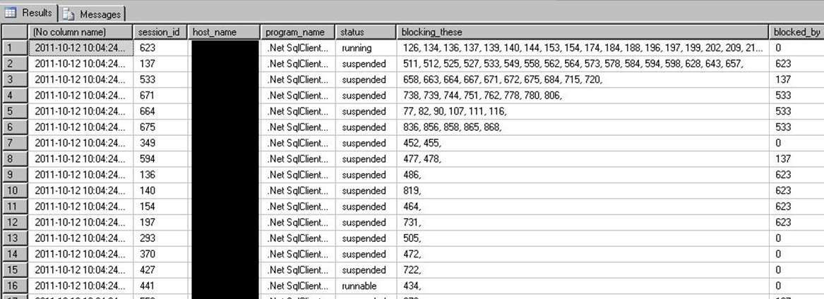
Sessions + Requests
Put them together for a status query far more detailed than SP_WHO2! Lab: sessions and requests.sql

Slide 46
Index DMV’s YOU Should KNOW
Physical stats DMV’s:
Help you evaluate need for index maintenance
Missing Index DMV’s:
Help you design new indexes
Index Usage Stats DMV:
Helps you evaluate existing index usage

Slide 47
sys.dm_db_index_physical_stats
Determine index fragmentation to do SQL-level defrag.
Root of all index fragmentation monitoring queries.
avg_fragmentation_in_pct shows logical fragmentation for indexes and extent fragmentation for heaps.
Replaces the functionality of DBCC SHOWCONTIG to an extent.
(that’s a pun, get it?)

Slide 48
sys.dm_db_index_physical_stats
Compared to DBCC SHOWCONTIG, which still works, sys.dm_db_index_physical_stats is more accurate. The fragmentation will appear higher.
For example, in SQL Server 2000, a table is not considered fragmented if it has page 1 and page 3 in the same extent but not page 2. However, to access these two pages would require two physical I/O operations, so this is counted as fragmentation in SQL Server 2005 and above.

Slide 49
sys.dm_db_index_physical_stats
Will still show tables without clustered indexes as Index_id = 0, this is a HEAP. Almost always, a heap is poor design or an oversight.
However, heap fragmentation isn’t meaningful.
Index_ID = 1 is the clustered index.
Index_ID >= 2 is every other index.

Slide 50
sys.dm_db_index_physical_stats
Avg_fragmentation_pct is a scale of 0 (not fragmented) to 100 (perfectly fragmented)
You may find it beneficial to perform some sort of index maintenance when avg_fragmentation_pct > 10, but this may vary.
You may find a better balance of meaningful performance protection and logged maintenance activity with less aggressive maintenance > 50.
Ideal strategy: defrag the most fragmented in every maintenance window, “take the top off” the stack.

Slide 51
INDEX MAINTENANCE
ALTER INDEX … REORGANIZE replaces
old DBCC INDEXDEFRAG
ALTER INDEX … REBUILD replaces old DBCC DBREINDEX, also updates the statistics
ALTER INDEX … REBUILD ALL rebuilds all indexes on a table, also updates the statistics, but not recommended.

Slide 52
sys.dm_db_index_physical_stats
When to use?
Use while your application is in production to identify tables that are generating fragmentation over time.
Then, only perform index maintenance on individual indexes as needed, and then, potentially only on partitions of indexes.

Slide 53
Index Maintenance
Custom scripts that use this selective approach work fine.
SSMS Maintenance Plans since SQL 2016 have dramatically increased capability to perform complex, conditional index maintenance operations.
You can configure the REORGANIZE and REBUILD tasks to maintain only indexes filtered by percentage of fragmentation level, or page count, as recommended.

Slide 54
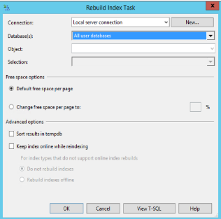
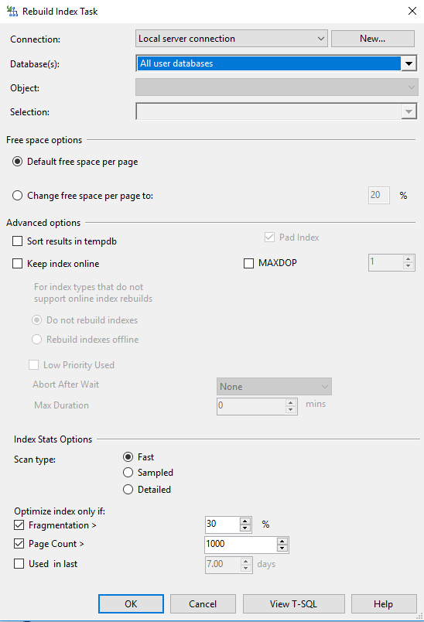
Index Maintenance
Rebuild Index Task
SQL 2014 vs SQL 2017

Slide 55
sys.dm_db_index_physical_stats
Typical usage for: one table in the current database,
all indexes and all partitions, default scan depth.
Select * from
sys.dm_db_index_physical_stats (
db_id(),
OBJECT_ID(‘dbo.person'),
NULL,
NULL,
NULL --mode)

Slide 56
sys.dm_db_index_physical_stats
MODE parameter options for Scan Depth:
LIMITED
Fastest, default, because it only scans parent-level pages, not leaf-level.
Only returns basic metrics, leaves the rest NULL.
Only mode that can be used on heaps.
Still can have an impact on production performance even on LIMITED mode.
SAMPLED
Not as fast, samples 1% of leaf pages.
DETAILED
Much more involved. Samples all data pages.
Will hammer your Disk IO. (Don’t run on production during business hours!)
Only way to get some of the columns to populate, but they are rarely needed.

Slide 57
sys.dm_db_index_physical_stats
Lab:
*lab - fragmented table.sql
*defrag.sql
automated index rebuild.sql

Slide 58
Aside, on Fragmentation
Why did the Microsoft Windows 7 RC download page break?
http://www.sqlskills.com/BLOGS/PAUL/post/Why-did-the-Windows-7-RC-failure-happen.aspx
Notes:
See this still happening in Microsoft products, including CRM.

Slide 59
sys.dm_db_index_physical_stats
Is it time to Compress?
If you haven’t begun using DATA_COMPRESSION in your ENTERPRISE edition SQL Server databases in SQL 2008 or higher, now is a good time.
In SQL 2016 SP1 – this feature was moved into STANDARD edition!
The Clustered Index and Nonclustered Indexes can be compressed independently from each other.
ALTER INDEX ALL ON schema.table REBUILD WITH (DATA_COMPRESSION = PAGE)

Slide 60
dm_db_column_store_row_group_physical_stats
Columnstore indexes have their own DMV for rowgroup status and fragmentation,
sys.dm_db_column_store_row_group_physical_stats
You need to include this DMV in any of your maintenance scripts if you have Columnstore indexes (and you probably should, they’re awesome SQL 2016+!).
Since Columnstore indexes are read-only prior to SQL 2016, this wasn’t needed in SQL 2012 or SQL 2014.

Slide 61
dm_db_column_store_row_group_physical_stats
You may find it necessary to REORGANIZE a Columnstore index multiple times before the rowgroups are compressed and the delta store rowgroups are moved to TOMBSTONE status.
Lab:
Defrag Columnstore.sql

Slide 62

Indexes

Slide 63
Missing Indexes Views
My favorite feature of introduced by SQL 2005.
A set of DMV’s record whenever a query plan recognized the need for an index that could have improved performance.
SQL records that recognized need, along with estimated statistics on cost and improvement of the new index.

Slide 64
Missing Indexes Views
sys.dm_db_missing_index_groups
sys.dm_db_missing_index_group_stats
sys.dm_db_missing_index_details
Passive. Already running. Doesn’t need to be enabled.
Cleared out when the server is rebooted, also cleared out for a table when you alter the table or indexes on that table.
Only recommends nonclustered indexes.
Won’t recommend a clustered index on a heap, you have to fix that!
Won’t recommend columnstore, xml, spatial index types.

Slide 65
Missing Indexes Views
Must be used with sobriety. Don’t create every suggested missing index or your update/insert/deletes will suffer.
Nonclustered Indexes are physical data copies of your table, and must be kept up to date too.
Writes can benefit from nonclustered indexes by making more efficient queries from the source query (seeks instead of scans).

Slide 66
Missing Indexes Views
Few indexes should be created to satisfy many suggestions.
Suggestions may only differ by column order, the columns in the key vs. INCLUDE’d, or by a small number of columns.
Combine suggestions together with common keys, a combined INCLUDE list.
Combine with existing indexes on the table as well, potentially replacing an old index.
However, be careful not to change the uniqueness of the table. A unique index = a unique constraint.

Slide 67
Missing Indexes Views
When to use?
After you have actual usage running against production.
Don’t use during development, too likely to be misleading.
Do use during user testing to simulate actual usage.
Do use on your production environment after a stable period of active and typical activity.
Try to capture a business cycle (weekly payroll, month-end reporting, quarterly or annual, etc.)

Slide 68
Missing Indexes Views
This is a very fast way to enter an environment and take a peek at the indexing situation.
Are there lots of missing indexes screaming to be created?
Are there indexes only in certain areas of the application?
Were indexes carefully created at the start of the application, but not recently?

Slide 69
Final Note on Missing Indexes Views
Since SQL 2008 – Missing index views have been integrated into the show query plan screens in SSMS.
But don’t use this to create new indexes. Very few queries are important enough to deserve their own indexes.
Take a look at the whole picture, including all suggested indexes and all existing indexes before creating any indexes.
Treat this as an alert!

Slide 70
Missing Indexes Views
Lab
lab - missing index setup demo.sql
missing indexes.sql

Slide 71
sys.dm_db_index_usage_stats
Tracks access operations on all indexes and HEAPs, cumulatively.
Data resets with the instance or if db is detached.
Retains data through maintenance operations.
Joins to sys.indexes on object_id and index_id

Slide 72
sys.dm_db_index_usage_stats
How to use?
Zero values in user_lookups, user_seeks, and user_scans = This index isn’t being read from.
User_updates (writes) greater than the sum of reads = This index might hurt more than it helps.
This criteria could be different based on intended table usage.

Slide 73
sys.dm_db_index_usage_stats
When to use?
Similar to the missing index DMV’s.
Use after a stable period of actual production use.
Try to capture a business cycle (weekly payroll, month-end reporting, quarterly or annual, etc.)
Lab: index_usage_stats.sql

Slide 74
Index DMV’s in Summary
Physical stats DMV’s:
Help you evaluate need for index maintenance
Missing Index DMV’s:
Help you design new indexes
Index Usage Stats DMV:
Helps you evaluate existing index usage

Slide 75
DMV Rapid-fire ROUND BEGINS

Slide 76
sys.dm_os_performance_counters
Query Perfmon stats with T-SQL (not WSQL!)
Replaces the deprecated sys.sysperfinfo
Includes hundreds of “SQLServer:” related performance counters, including all instances.
Slightly more involved to read than the values out of perfmon
For example, need to actually do some division between two rows to get the Buffer Cache Hit Ratio – a useful memory usage counter.

Slide 77
sys.dm_os_performance_counters
Lab
dm_os_performance_counters.sql
page life expectancy.sql

Slide 78
sys.dm_os_sys_memory
Includes total and available physical memory and cache levels.
Built in flags for Low/High memory availability from Windows
Application can use to automatically scale itself up/down based on available server memory.
Same technology is used for Windows memory pressure notifications in Hyper-V Dynamic Memory.

Slide 79
sys.dm_server_services
SQL Server instance service information, including the last time the service was started, service file location, clustering information and service account name.
SELECT servicename -- SQL Server Instance name
, startup_type_desc -- Manual, Automatic
, status_desc -- Running, Stopped, etc.
, process_id
, last_startup_time -- datetime
, service_account
, filename
, is_clustered -- Y/N
, cluster_nodename
FROM sys.dm_server_services

Slide 80
sys.dm_server_registry
Returns potentially 100s of rows for all SQL-related registry keys and values in these locations:
HKLM\SYSTEM\CurrentControlSet\Services\
HKLM\Software\Microsoft\Microsoft SQL Server\instance\MSSQLServer\ (per instance)
HKLM\Software\Microsoft\Microsoft SQL Server\instance\SQLServerAgent (per instance)
SELECT
registry_key
, value_name
, value_data
FROM sys.dm_server_registry;

Slide 81
sys.dm_server_registry
SELECT
registry_key, value_name, value_data
FROM sys.dm_server_registry
WHERE registry_key like 'HKLM\Software\Microsoft\Microsoft SQL Server\%\MSSQLServer\Parameters'
value_name | value_data
SQLArg0 | -dE:\Program Files\Microsoft SQL Server\MSSQL14.SQL2K17\MSSQL\DATA\master.mdf
SQLArg1 | -eE:\Program Files\Microsoft SQL Server\MSSQL14.SQL2K17\MSSQL\Log\ERRORLOG
SQLArg2 | -lE:\Program Files\Microsoft SQL Server\MSSQL14.SQL2K17\MSSQL\DATA\mastlog.ldf

Slide 82

sys.dm_os_volume_stats
Bypass WMI calls – get physical drive size/available space from within SQL
Join to sys.master_files to info on data and log files
Unfortunately, for space on ALL disks, still have to use ye olde exec xp_fixeddrives
Lab:
volume stats.sql
job - Volume Stats Monitoring for Production.sql

Slide 83
sys.dm_DB_LOG_STATS
New for SQL 2016 SP2+ and SQL 2017
A handy DBA-friendly one-stop-shop dashboard of transaction log metrics including:
VLF size and counts
log reuse reason
backups
Going forward, use instead of DBCC LogInfo

Slide 84
sys.dm_DB_LOG_STATS
Databases with too many VLF’s can be problematic when a database is recovered, negatively affecting startup and restore times.
You can also now see individual VLF information in sys.dm_db_log_info, instead of using DBCC LOGINFO.
Lab:
vlfs analysis.sql

Slide 85
Sys.dm_io_virtual_file_stats
Includes an ascending counter in milliseconds that can be used to measure the data volume over intervals,
For example:
Number of reads/writes issued to a file
and volume in bytes
IO waits/stall per file and overall IO latency for reads/writes
Lab:
record_dm_io_virtual_file_stats.sql

Slide 86
Sys.dm_OS_RING_BUFFERS
Access to ring buffer endpoints of XEvents sessions
The System Health session already gathers a lot of data, including a history of CPU, Memory utilization.
The default system_health xevent session the only way to find Deadlocks in the recent past without having set up anything to capture them. It writes to ring_buffer and .xel.
Lab:
sys_dm_os_ring_buffers.sql
deadlocks in xevents.sql
cpu utilization.sql

Slide 87
sys.dm_hadr_cluster
Returns information about Availability Groups
Not AlwaysOn cluster, not DAG… Availability Groups.
Doesn’t matter if primary or secondary, but many DMV’s require you to run on the current primary replica for an AG to see complete information.
Also use sys.dm_hadr_cluster_members to see members.

Slide 88
sys.dm_hadr_cluster
Combine with
Sys.dm_hadr_database_replica_states,
and sys.dm_os_performance_counters
for a performance snapshot of Availability Groups,
Including all current configuration, and endpoints
Including your current RPO/RTO (especially useful for asynchronous replicas) and last commits
Lab: AG - Monitor.sql

Slide 89
Sys.dm_db_page_info
New in SQL 2019, replaces most of DBCC Page
No need for trace flag 3604 to see data
DMF – can be joined to other DMO’s
Also new in SQL 2019, sys.fn_PageResCracker, which accepts a hexadecimal from sys.dm_exec_requests.page_resource if the wait_resource type is PAGE.
So, it’s limited. Doesn’t return info for other wait_resources like KEY.

Slide 90
Helpful links, sources, and continued reading:
http://www.sqlskills.com/BLOGS/PAUL/post/Why-did-the-Windows-7-RC-failure-happen.aspx
http://technet.microsoft.com/en-us/library/cc966413.aspx
http://msdn.microsoft.com/en-us/library/ms188917.aspx
http://www.codeproject.com/KB/database/Dynamic_Management_Views.aspx
http://glennberrysqlperformance.spaces.live.com/blog/cns!45041418ECCAA960!1446.entry
http://sharmilasanctuary.wordpress.com/about/database-performance-dmvs-for-ms-sql-2005/
http://sqlblog.com/blogs/kevin_kline/archive/2009/04/07/looking-for-good-dmv-database-admin-queries.aspx
http://blogs.msdn.com/jimmymay/archive/2008/10/30/drum-roll-please-the-debut-of-the-sql-dmv-all-stars-dream-team.aspx
http://blogs.msdn.com/psssql/archive/2007/02/21/sql-server-2005-performance-statistics-script.aspx
http://msdn.microsoft.com/en-us/magazine/cc135978.aspx
http://www.sqlservercentral.com/articles/DMV/64425/
http://www.sqlskills.com/BLOGS/PAUL/post/Inside-sysdm_db_index_physical_stats.aspx
http://www.sqlskills.com/BLOGS/PAUL/post/Indexes-From-Every-Angle-How-can-you-tell-if-an-index-is-being-used.aspx
http://kswain.blogspot.com/2008/04/sysdmosperformancecounters-dynamic.html
http://www.sqlpassion.at/archive/2014/11/24/deadlocks-caused-by-missing-indexes-in-sql-server
http://www.sql-server-performance.com/articles/per/bm_performance_dashboard_2005_p2.aspx
http://msdn.microsoft.com/en-us/library/aa366541%28VS.85%29.aspx
http://sqlblog.com/blogs/aaron_bertrand/archive/2011/04/25/more-changes-you-might-not-have-noticed-in-the-sql-server-2008-r2-sp1-ctp.aspx
http://www.sqlskills.com/BLOGS/PAUL/category/Spinlocks.aspx
https://www.sqlshack.com/sql-server-2019-new-dmf-sys-dm_db_page_info/

Slide 91



HEALTH CHECK
REMEDIATION
MANAGED SQL
What’s covered in the Health Check?
Windows Server and VM Host/Guest configuration, Patching
Disaster Recovery, High Availability solutions
SQL Server Configuration, Database Configuration
Security, Permissions and Authentication assessment
Regular Maintenance, Alerts and Monitoring, Performance Monitoring
Special focus on any areas of client need
For example: performance, pre-audit, security

Slide 92
HEALTH CHECK
REMEDIATION
MANAGED SQL
Remediation
We document findings, issues, and recommendations.
Divide into actionable steps towards increased maturity.
Remediation will be thoroughly detailed, executed collaboratively.
Stabilize the SQL environment for maintenance/monitoring.
Onsite or Remote, scheduled around Maintenance Windows.

Slide 93
HEALTH CHECK
REMEDIATION
MANAGED SQL
Managed SQL
Proactive Health Checks, Reactive Alerting, Integrated Processes
Leverage Sparkhound’s internal expertise delivering Managed Services, also including Managed SharePoint, Infrastructure, Support Services.
Single Point of Contact - Service Desk 24x7x365, dedicated 1-800.
Remote Support - Engage Tier 1-3 support remotely as appropriate.
Ticketing – Use our enterprise ticketing system or integrate.
Health - Monthly Stable State Health Check to deliver regular reports.

Slide 94
SQL Consulting Services
Performance Tuning
SSIS/SSRS
Upgrades/Migrations/Data Conversions
High Availability/Disaster Recovery solutions
Pre-audit, encryption, database security
Maintenance/administration
Automation/PowerShell
Azure SQL (IaaS or PaaS) architecture
Training/Knowledge Transfer/Skillset updates

Slide 95
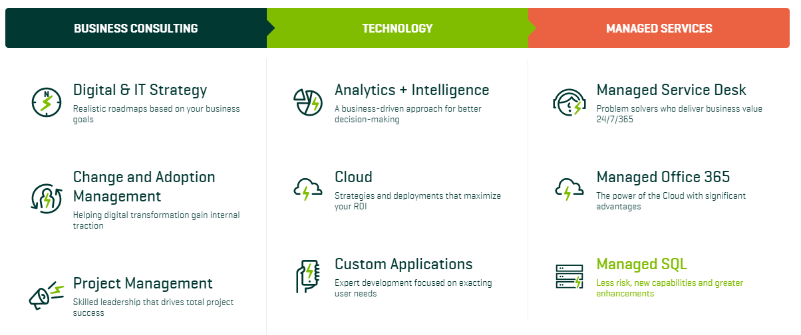
Sparkhound

Slide 96


Slide 97
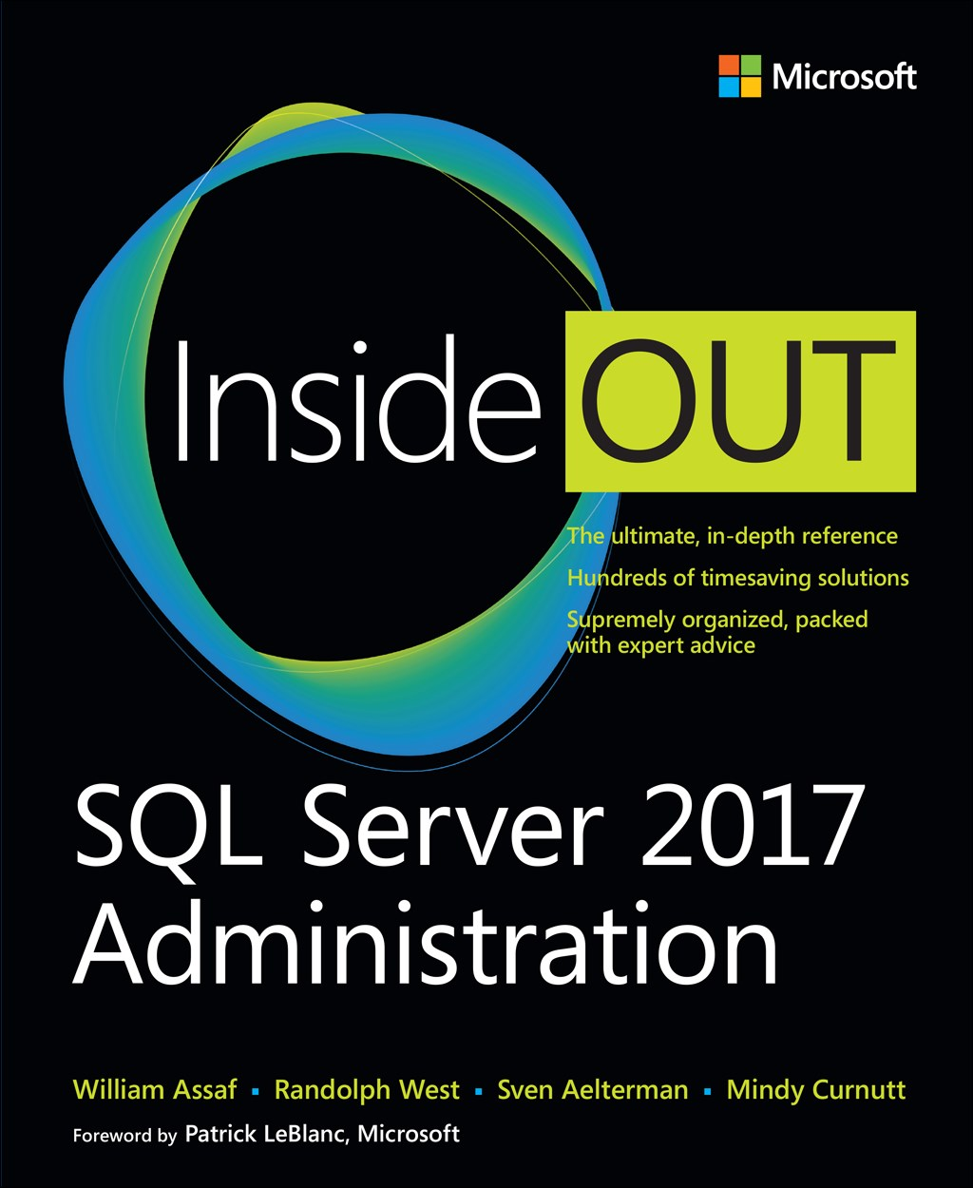
SQL Server 2017 Administration Inside Out
Published Feb 2018 by Microsoft Press
2nd edition for SQL 2019 coming Q4’2019*
*just a guess

Slide 98





Free SQL Server, .NET, Business Intelligence training and more!
An all day FREE training event with SQL Server and Development related sessions spread out over multiple tracks of Business Intelligence, SQL Development,
Database Administration, IT Pro, .NET,
Career Development, and CIO/IT Management
See you August 17 at
SQLSatBR.com

Slide 99

Bio and contact
William D Assaf, MCSE
Baton Rouge SQL Server UG board and SQLSat chair
Principal Consultant, Manager – DBA Team at
Sparkhound Inc.
William.Assaf@sparkhound.com
Twitter: @william_a_dba
This presentation, including all source code, available at this SQLSaturday’s schedule page and at my blog:
SQLTact.com

